Slide 1
It is the mission of the Iona Bonneville Sewer District to provide the current and future residents of Iona and the surrounding areas of Bonneville County with cost effective wastewater conveyance and treatment while protecting our natural resources and community environment for future generations.
https://sewerdistrict.com

Slide 2
IBSD Is Committed To
PATRONS Meeting the needs and expectations of its patrons in providing these sewer services at a reasonable rate, providing prompt, effective, friendly, and dependable service to the community, and always treating all of its patrons, customers, affiliates, vendors, and employees with the highest degree of respect and integrity. | QUALITY, AFFORDABLE SERVICE Continually working with its patrons, governmental agencies, the community, and industry to maximize the quality and affordability of service while maintaining the highest ethical and business standards. | EMPLOYEES Constantly striving to promote a safe, supportive and efficient work environment for its employees and associates that encourage a high degree of professionalism, creativity, and job satisfaction.
PLANNING Providing long-range planning that ensures continuous cost-effective service for the future needs of the District. | ENVIRONMENT Reaching out to the community in the spirit of cooperation to conserve our natural resources and environment and to make a conscious effort to protect the environment in the performance of its duties so that all can continue to enjoy a safe and pleasant place to live.
https://sewerdistrict.com/ibsd-is-committed-to/

Slide 3
IBSD Board Concerns
*Service Area and ability to serve
*Rates

Slide 4
District Boundary

Slide 5
Future Growth Projections
Current
8,337 EDUs
~200-300 new connections per year
3.7% annual growth rate
20-Year Projection
13,800 EDUs
40-Year Projection
19,100 EDUs

Slide 6
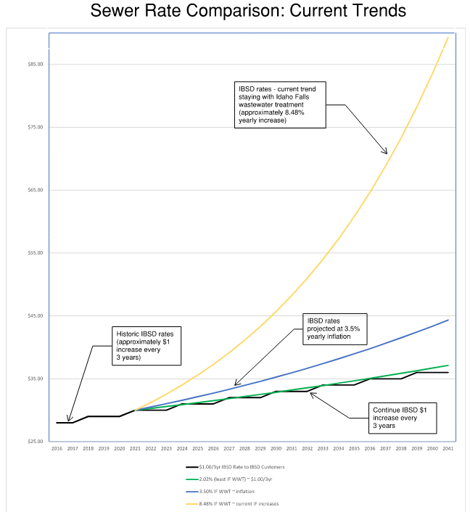

Slide 7
Wastewater Treatment Options
Customer
Owner

Slide 8
Wastewater Treatment Options
Customer
Owner
Existing Service
City of Idaho Falls maintains IF WWT and IBSD lines
City of Idaho Falls manages growth of IBSD
Impacts:
IF dictates service and growth
IF controls costs (increasing)
IBSD value diminished
IBSD provide WWTP
IBSD maintain IBSD
lines
IBSD manage IBSD
Service to growth areas
Impacts:
Serves IBSD & growth areas
IBSD controls costs
IBSD Mission Valued

Slide 9
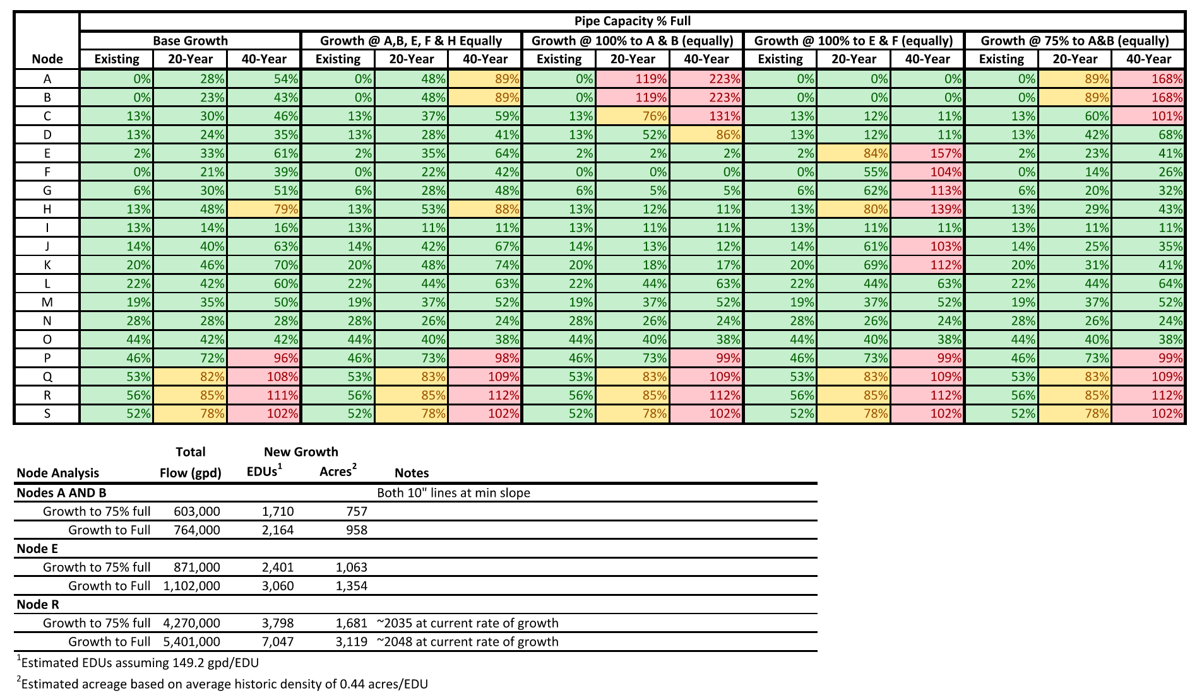
Pipe Capacity Analysis

Slide 10
Where Does the Water Go?
Mechanical Treatment Plant
Lagoon
Surface Water
Land Application – Class A
Groundwater Recharge
Land Application – Class B

Slide 11
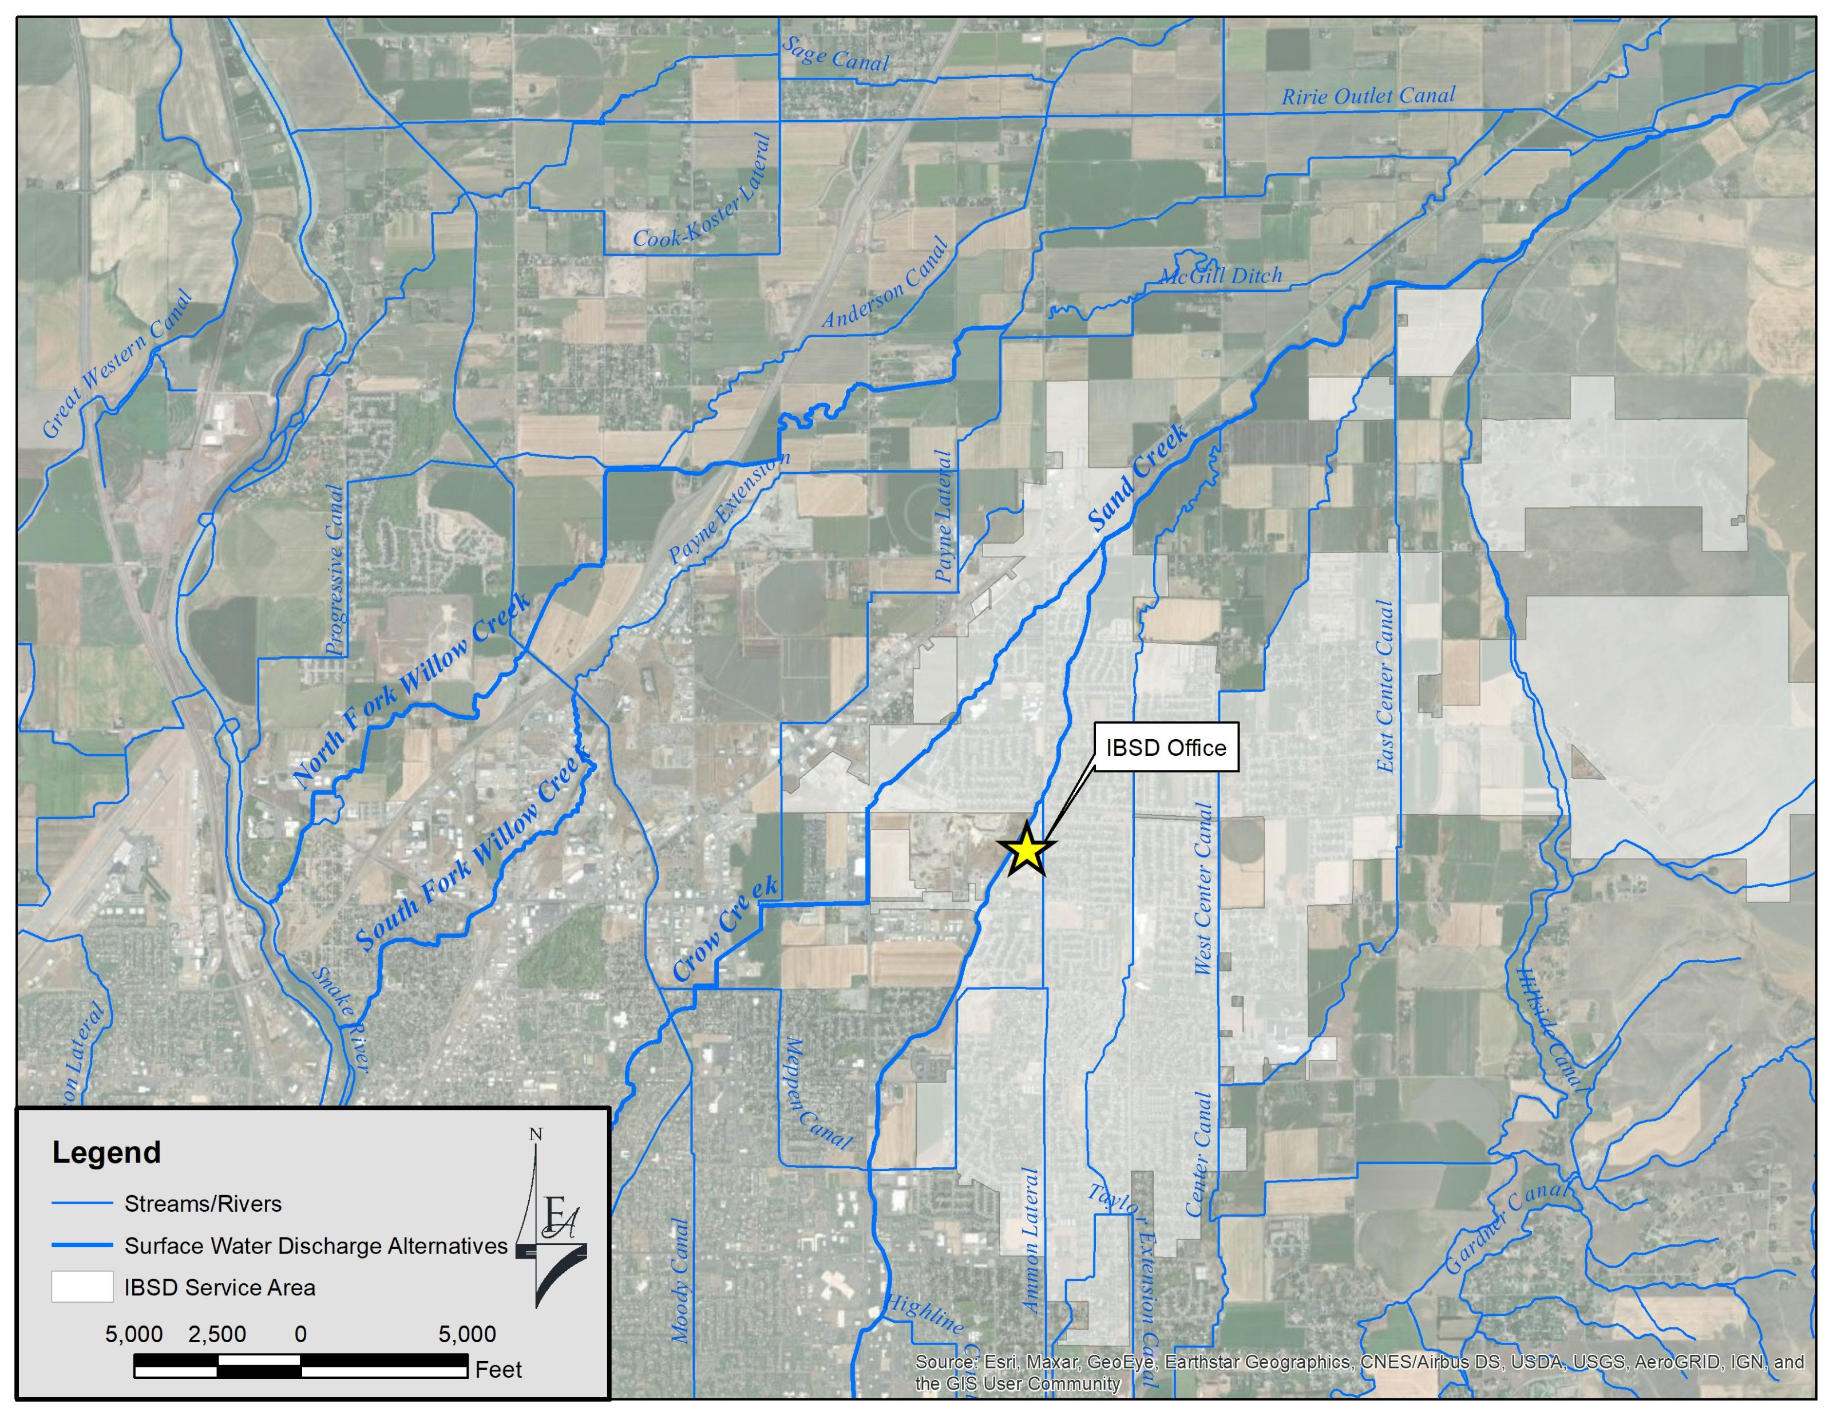
Surface Water Discharge Locations

Slide 12
IBSD Decision
September 14, 2022
IBSD Owned and Operated Wastewater Treatment
Compliance
Capacity
Feasibility
Capital Cost
O&M Cost
Life Cycle
Supports IBSD Mission Statement
It is the mission of the Iona Bonneville Sewer District to provide the current and future residents of Iona and the surrounding areas of Bonneville County with cost effective wastewater conveyance and treatment while protecting our natural resources and community environment for future generations.

Slide 13
IBSD Wastewater System
Final Wastewater System Facility Planning Study 2022
Recommended:
IBSD-owned WWTP, discharge to groundwater recharge, and improvements to wastewater collection
$60M
Funding Scenarios

Slide 15
